Slide 1
For information about membership opportunities, please contact:
Larry Clinton
President & CEO
lclinton@isalliance.org
(703) 907-7028
For more information about the Internet Security Alliance, please visit www.isalliance.org

Slide 2
How Good are our defenses?
The military’s computer networks can be compromised by low to middling skilled attacks. Military systems do not have a sufficiently robust security posture to repel sustained attacks. The development of advanced cyber techniques makes it likely that a determined adversary can acquire a foothold in most DOD systems and be in a position to degrade DOD missions when and if they choose.” Pentagon Annual Report Jan 2015.

Slide 3
Non-DoD Agencies ? Worse
Compared to industry sectors fed agencies rank dead last in terms of finding and fixing flaws
Comply w/security standards 24%
Patch 27% of the time
GAO Fed agencies don’t use risk management – they use the “policy” method
Fed agencies often have right tools but don’t have the right people to operate them

Slide 4
Things are going to get worse …much worse
The system is getting even weaker
The attackers are getting much better
Cyber Economics all favor the bad guys
The real crazies could become a real threat

Slide 5
Progress on a Path Forward
The Cyber Security Social Contract
Pan industry White Paper
Obama’s Cyber Space Policy Review
House GOP Task Force Report
Obama EO 13636
Info sharing Legislation
Trump Cyber EO
HHS Industry Cybersecurity Task Force Report
Just not doing it fast enough

Slide 6
What to do
Act with (much) greater urgency
Spend (a lot) more money
Its not JUST about Critical Infrastructure – focus on cyber as a law enforcement issue
Organize for the Digital Age
Streamline Cyber Regulations
Test the NIST Framework
Educate Senior Govt. Executives

Slide 7
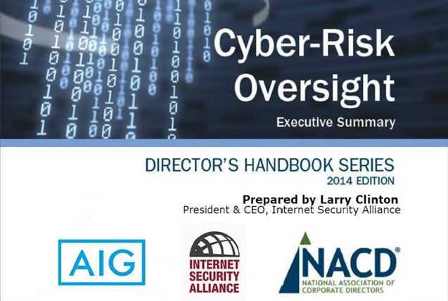

Slide 8
Corporate Boards are getting involved
Guidelines from the NACD advise that Boards should view cyber-risks from an enterprise- wide standpoint and understand the potential legal impacts. They should discuss cybersecurity risks and preparedness with management, and consider cyber threats in the context of the organization’s overall tolerance for risk. -- PWC 2016 Global Information Security Survey

Slide 9
Boards are taking action
Boards appear to be listening to this advice. This year we saw a double-digit uptick in Board participation in most aspects of information security. Deepening Board involvement has improved cybersecurity practices in numerous ways. As more Boards participate in cybersecurity budget discussions, we saw a 24% boost in security spending. --- PWC 2016 Global Information Security Survey

Slide 10
Actual Cyber Security Improvements
Notable outcomes cited by survey respondents include identification of key risks, fostering an organizational culture of security and better alignment of cybersecurity with overall risk management and business goals. Perhaps more than anything, Board participation opened the lines of communication between the cybersecurity function and top executives and directors -- PWC
2016 Global Information Security Survey

Slide 11
What to do (cont.)
Adopt a risk management approach to cyber security
Workforce development focus as much on people as tech and make cyber security cool
Define Govt role in nation state attacks
Realign the cyber incentives
Rethink the compliance model

Slide 12
HHS Industry Cybersecurity Task Force Report
ISA Policy Positions
Harmonize, Streamline & Rationalize Healthcare Sector Cybersecurity Regulations (ISA Trump EO Memos; ISA Cybersecurity Social Contract)
Agency Heads Should receive Cyber-Risk Management Training (ISA Trump EO Memos; ISA Cybersecurity Social Contract)
Government and industry need to partner together to develop shared goals and priorities (ISA Cybersecurity Social Contract)
HHS Cybersecurity Report Recommendations
Require federal regulatory agencies to harmonize existing & future laws and regulations that affect healthcare industry cybersecurity (Rec 1.3)
Develop executive education programs targeting executives and Boards of Directors about the importance of cybersecurity education (Rec 4.1)
Industry and government should partner to establish prioritized best practices for the healthcare sector (Action Item 1.2.3)

Slide 13
HHS Industry Cybersecurity Task Force Report (cont.)
ISA Policy Positions
Incentivize Healthcare to Implement Best Cybersecurity Practices (ISA Trump EO Memos; ISA Cybersecurity Social Contract)
Reform the Cybersecurity Auditing process (ISA Trump EO Memos; ISA Cybersecurity Social Contract)
HHS Cybersecurity Report Recommendations
The Report lists a plethora of incentive options for the healthcare sector, including:
  A Cash for Clunkers for upgrading IT infrastructure (Action Item 2.1.4)
  Grants and tax incentives for small businesses who show they are actively improving cybersecurity profiles (Action Items 3.3.1, 3.3.2, 3.4.1, 3.4.2)
Establish a conformity assessment model for evaluating cybersecurity hygiene that regulatory agencies and industry could rely on (Rec 4.3)

Slide 14
HHS Industry Cybersecurity Task Force Report (cont.)
ISA Policy Positions
Workforce Development: focus on recruiting people to help fill the workforce development gap, which goes beyond technical expertise and runs to overall risk management (ISA Trump EO Memos; ISA Cybersecurity Social Contract)
Government priority for working with the private sector should be reversed to emphasize smaller companies (ISA Cybersecurity Social Contract)
HHS Cybersecurity Report Recommendations
Develop the healthcare workforce capacity necessary to prioritize and ensure cybersecurity awareness and technical capabilities (Imperative 3)
Increase healthcare industry readiness through improved cybersecurity awareness and education (Imperative 4)
Congress should identify resources for improving research addressing small and rural provider security challenges (Action Item 5.1.4)
Industry should develop use cases and contracts tailored for small and medium-sized organizations (Action Item 3.4.4)

Slide 15
HHS Industry Cybersecurity Task Force Report (cont.)
ISA Policy Positions
Government should restructure information-sharing programs to make them more user friendly to smaller firms (ISA Cybersecurity Social Contract)
The NIST Cybersecurity Framework needs to be assessed to determine use, effectiveness, and cost effectiveness, so that elements can be properly prioritized (ISA-FAIR Joint Comments on NIST CSF v1.1; ISA Cybersecurity Social Contract)
HHS Cybersecurity Report Recommendations
Tailor information-sharing for easier consumption by small and medium-sized organizations who rely on limited or part-time security staff (Rec 6.1)
HHS and NIST must develop guidance about how to apply the framework to the healthcare sector (Action1.2.2)

