Slide 1

Trusted AI for the Energy Sector
ISA BOARD EXECUTIVE BRIEFING
July 7, 2026

Slide 2

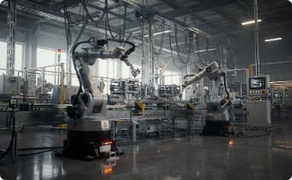


AI Changes Every Layer of the Industrial Value Chains
AI is not a single technology decision — it is a transformation across every function, from corporate strategy to field operations. Each layer introduces distinct implementation requirements that extend well beyond cybersecurity into engineering, procurement, legal, and product management.
Product Engineering
Manufacturing & OT
Supply Chain
Operations & Field Services
AI copilots accelerate software and firmware development. Governance requires AI model validation within the Secure Development Lifecycle, adversarial testing, SBOMs, and AIBOMs.
AI improves quality and predictive maintenance. Controls include data governance for training sets, logical separation from ICS, mandatory human in the loop for production decisions, and model drift monitoring.
Suppliers embed AI into products and software. Implementation demands AI governance clauses in procurement contracts, vendor AI usage disclosure, third-party maturity assessments, and component validation pre-integration.
AI informs grid management and field dispatch decisions. Governance requires decision audit trails, defined human-in-the-loop thresholds, incident response protocols for AI failures.
These challenges are shared across Energy, Healthcare, Financial Services, Manufacturing, Telecommunications, and Transportation.

Slide 3
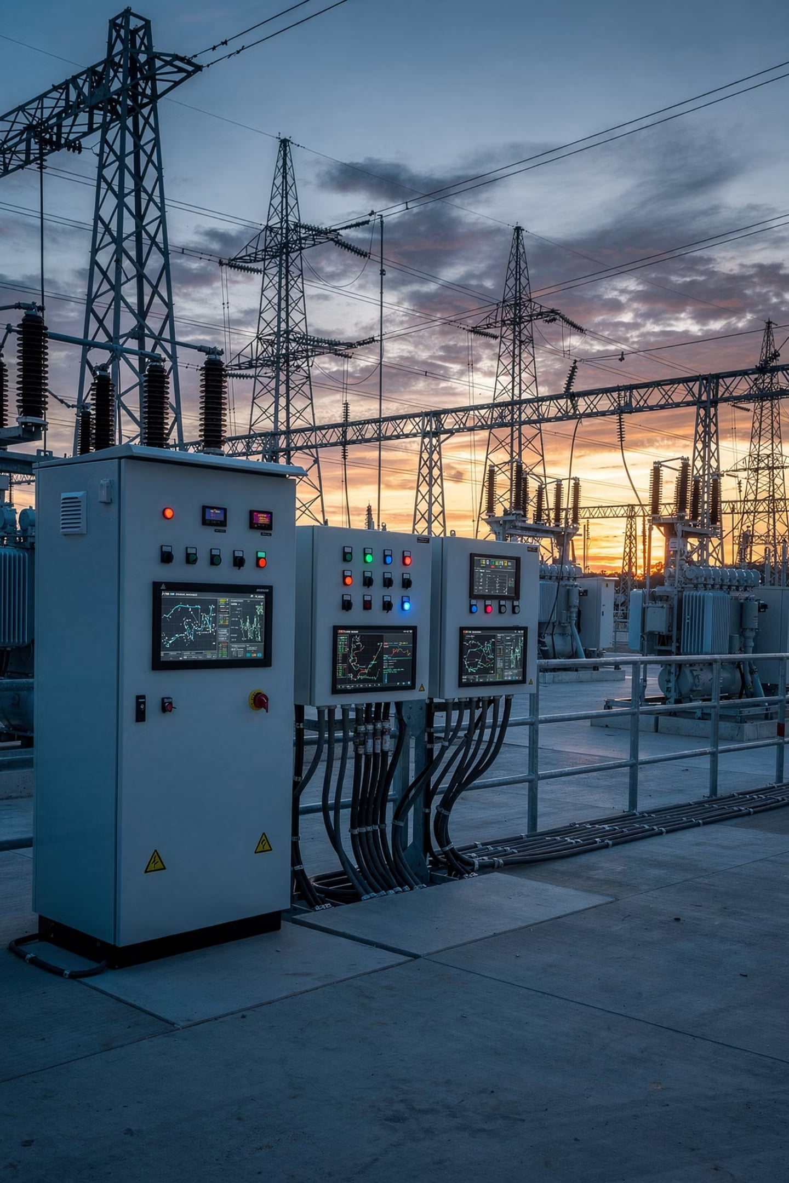
Energy Industry Considerations
AI is becoming embedded in every layer of how power is generated, transmitted, managed, and delivered.
Grid Modernization
AI-driven grid management, smart devices, and distributed energy create new attack vectors.
Industrial Automation
Robotics, connected manufacturing, software-defined equipment, and OT convergence…outages or cyber attacks can lead to physical consequences.
Connected Products
Field-deployed equipment now carries embedded software and remote connectivity — expanding the enterprise security perimeter into the physical world.
Customer Platforms
Digital service platforms and customer-facing tools aggregate sensitive operational data, creating concentration risk if AI safeguards are absent.

Slide 4


Deeper Dive into Energy
Reshaping Cyber Risk for the Energy Sector
AI simultaneously lowers the cost, speed, and sophistication of attacks while accelerating operational efficiency across the enterprise. For Energy companies, this duality demands board-level attention.
Threat Side: AI-Enabled Attacks
Exposure Points: Energy Sector Attack Surface
AI-Generated Phishing, Smishing
Connected Grid & Smart Substations
ICS / SCADA Systems
Highly personalized campaigns targeting utility executives and finance teams — including deepfake voice fraud to authorize wire transfers
AI-Assisted Vulnerability Discovery, e.g., Mythos, et al
Digital Twins & Predictive Maintenance
Industrial IoT & Field Devices
Nation-states using AI to identify exploitable weaknesses in industrial software, ICS/SCADA, and grid management systems at machine speed
Software-Defined Power Equipment
AI Engineering Assistants
AI-Accelerated Ransomware
Autonomous malware targeting operational technology — capable of self-propagating across smart substations, digital twins, and connected field equipment
PLUS… Cyber Insurance implications, Global Regulatory considerations, Supply Chain and customer contracts/agreements
Takeaway: AI is transforming cyber risk from a technology issue into an enterprise resilience and business strategy gap to close.

Slide 5
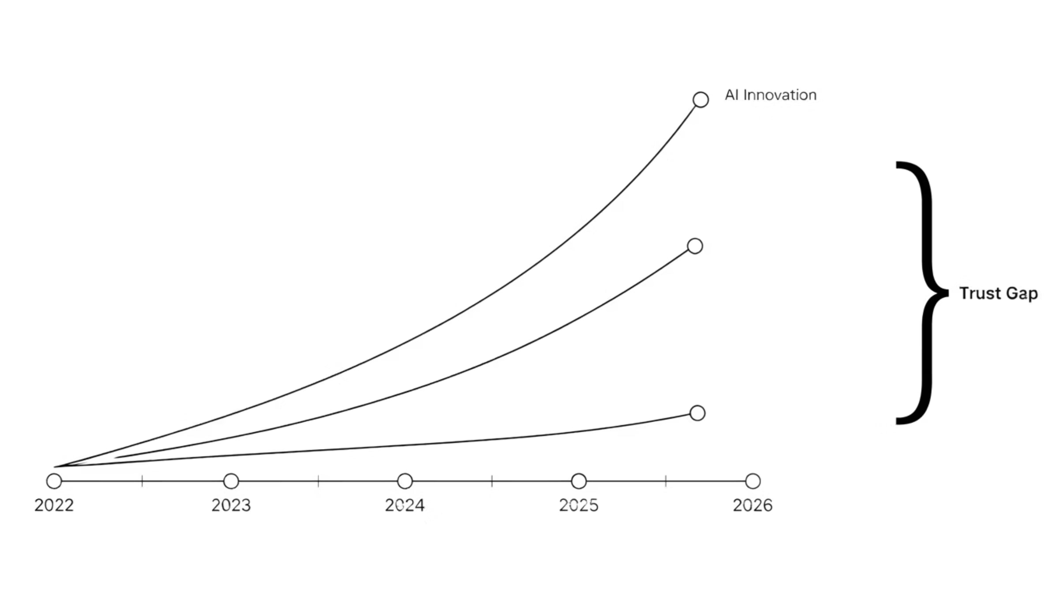
What's the underlying issue: AI Trust Gap
AI is transforming faster than organizations, standards, and governments can establish consistent governance.
The challenge is not whether to adopt AI — it is how to deploy AI that customers, regulators, Boards, and society at large can trust.
The Energy sector uniquely combines critical infrastructure, industrial manufacturing, operational technology, and national security — making the trust gap impossible to ignore.
Corporate Implementation
Standards & Regulation

Slide 6

ISA Board Discussion
The Next Three Years Will Define Trusted AI
The window to shape Trusted AI governance is open now. How will the ISA Board lead the conversation to close the gap?
From Fragmentation to Shared Leadership
Board-Level Evidence
Industry Experience Shaping Policy
What evidence should Boards consistently expect from management to demonstrate that AI is being deployed responsibly, securely, and in ways that strengthen operational resilience — not just strategic aspiration?
How can ISA help move from isolated AI governance efforts to shared implementation patterns that accelerate trust across industries — reducing duplicated effort and elevating the baseline for all?
How should ISA partner with government, academia, and standards organizations to ensure that practical industry implementation experience informs future AI policy — rather than reacting to regulation after the fact?
Five years from now, ISA should be remembered as the organization that transformed AI risk management into trusted, cross-sector implementation guidance — shaping the principles on how industry, Boards, and government govern Trusted AI together.

Slide 7
Boards Should Expect Evidence — Not Aspirations
Approving an AI strategy is no longer sufficient — governing enterprise trust requires tangible evidence that management has operationalized AI risk broadly.
Board Expectation
Evidence Management Must Produce
How It Is Operationalized
Enterprise AI Visibility
AI inventory with accountable business owners and risk classification
Governance council, quarterly reviews, risk-tiered registry
Product Trust
AI validation reports, secure development evidence, adversarial testing results
SDL review gates, red-team exercises, AIBOM publication and sustainment
IP & Data Protection
AI usage monitoring, data classification policies, data loss metrics
DLP tooling, usage audit logs, access controls
Third-Party Governance
Vendor AI assessments, AI contract clauses, provenance documentation
Supplier scorecard, contract addenda, pre-integration validation
Operational Resilience
AI incident response plans, tabletop exercises, OT safeguards
Defined escalation paths, cross-functional drills, human override protocols
Board Reporting
Quarterly Trusted AI dashboard with risk metrics, maturity scores, incidents
Standardized KPIs, executive scorecard, compliance status summary
The Board's role is no longer oversight of AI strategy — it is governing enterprise trust.

Slide 8



APPENDIX - Notional Timeline
Three-Year Vision: ISA as a AI Trust Council
A structured three-year roadmap to build ISA into the recognized cross-sector convening body for Trusted AI governance — expanding beyond CISOs to include engineering, product security, legal, risk, and board leadership.
2026 — Convene & Learn
2027 — Develop Guidance
2028 — Shape Global Leadership
Build cross-sector membership across Energy, Healthcare, Financial Services, Manufacturing, and government
Publish "Trusted AI for Critical Infrastructure" principles paper
Launch executive roundtables and board education sessions
Collect anonymized implementation case studies
Publish implementation patterns for AI governance, product security, and board oversight
Create AI maturity benchmarks and executive dashboards
Select reference architectures and procurement guidance (NIST, et al)
Conduct cross-sector tabletop exercises
Publish annual State of Trusted AI report (e.g. withing Critical Infrastructure)
Provide recommendations to policymakers and standards bodies
Host inaugural annual Trusted AI Summit
Expand our recognition as a global thought leaders in this space
500
7
3
Fortune 500 Companies
Critical Sectors
Year Roadmap
Target adoption of ISA Trusted AI guidance
Energy, Healthcare, Finance, Manufacturing, Tech, Telecom, Transport
From convening body to global thought leader on Trusted AI

